Slide 1
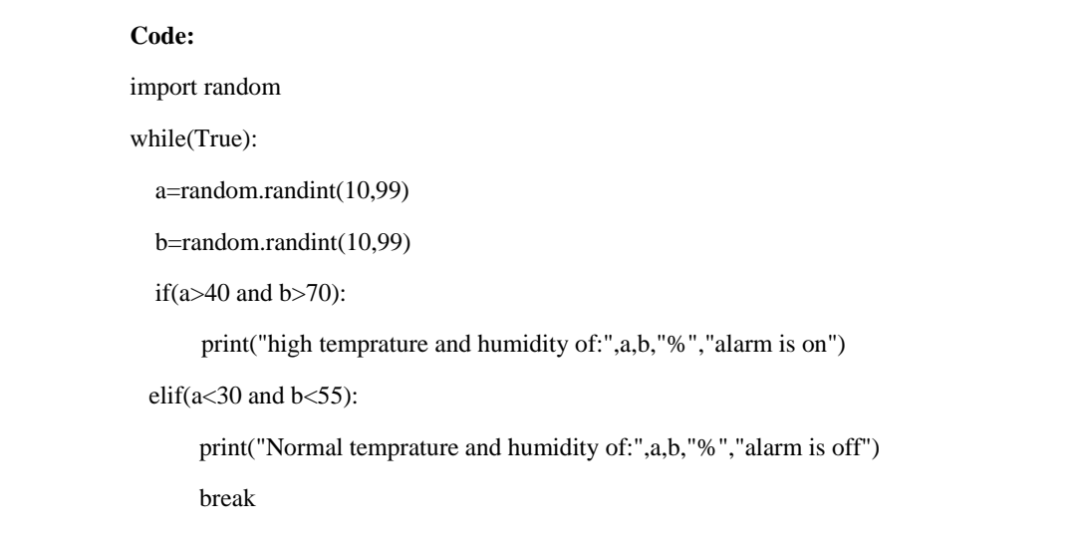
ASSIGNMENT NO -2
Project Name : IoT Based Smart crop protection System for Agriculture
Batch Number : B5-5M1E
Assignment Topic : Assignment on temperature and humidity sensing and alarm automation using python
TEAM MEMBERS
Team leader :Arun K Member-1 :Kalai Selvan P Member-2 :Manojraj M Member-3 :Kavibharathi K

Slide 2
